Slide 1
East Dean / Charlton / Singleton Infiltration Reduction Update
May 2024

Slide 2
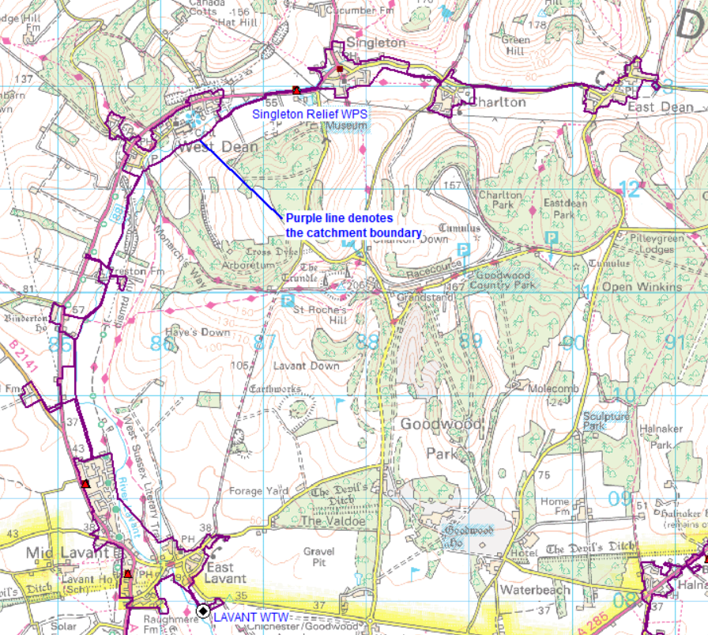

Lavant System 2014-2020
24 km of public sewer surveyed
All sewers surveyed by CCTV or Electro-scanned
75 sewer lengths sealed pre-2020. Circa 3.5 km.

Slide 3
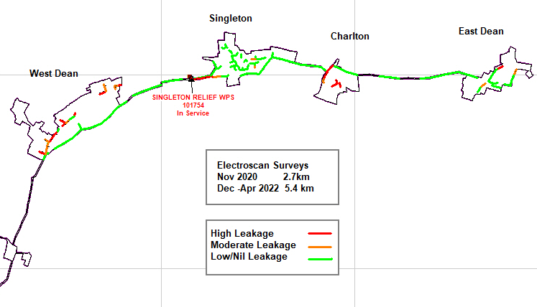
Lavant System – electroscan 2020-2022
Follow on surveys carried out on 8.1 km of sewer
High and moderate leakage accounted for 1.03km of sewer length
6.4km of lining /repairs carried out to date
1km of public sewer left to complete

Slide 4
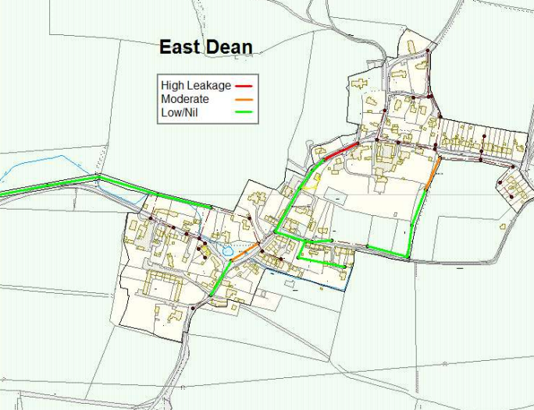
East Dean catchment survey

Slide 5
East Dean catchment lining
Sewer surveyed and sealed
Sewer outstanding to be sealed

Slide 6
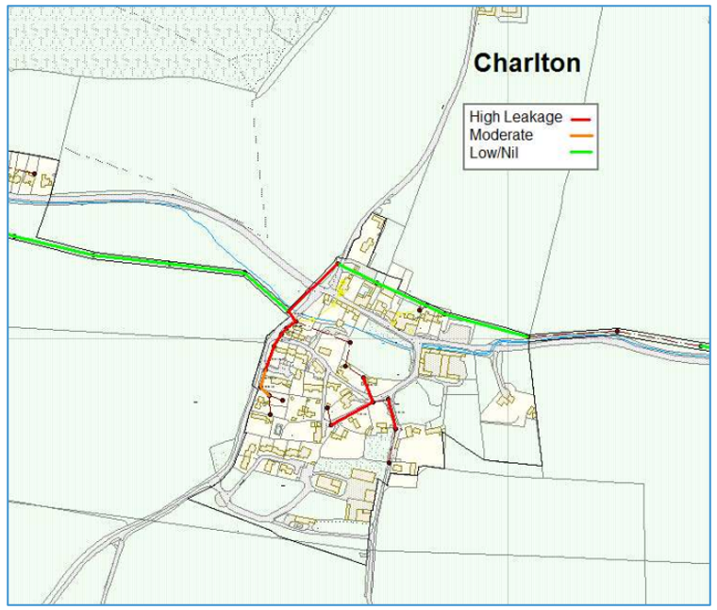
Charlton catchment survey

Slide 7
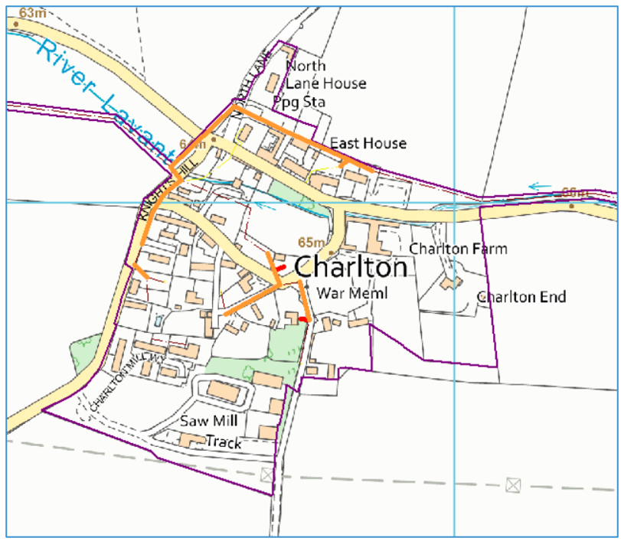

Charlton catchment lining

Slide 8
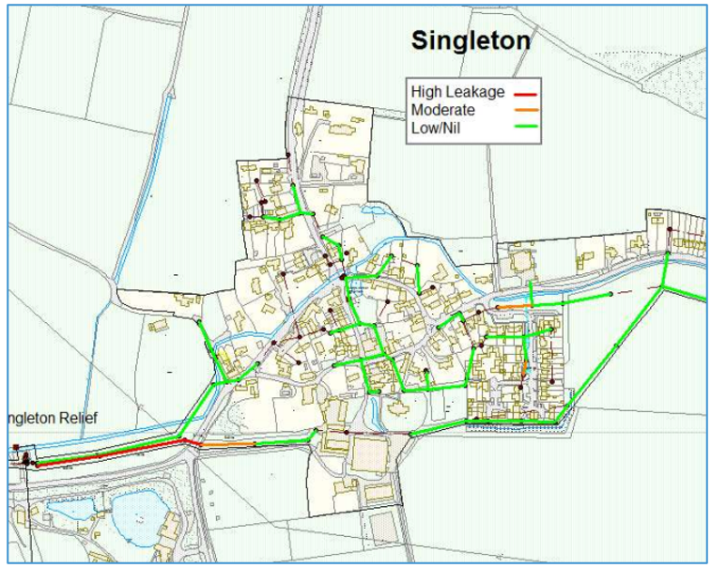
Singleton catchment investigation

Slide 9
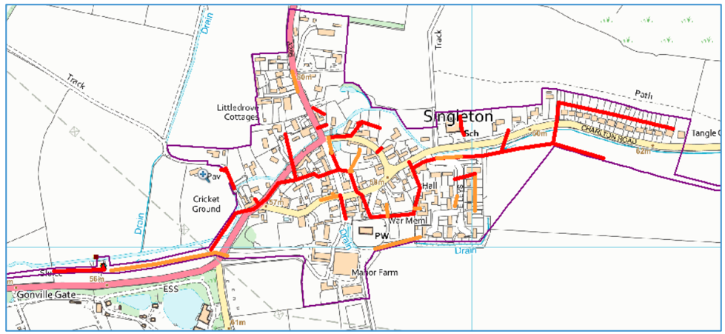
Singleton catchment lining

Slide 10
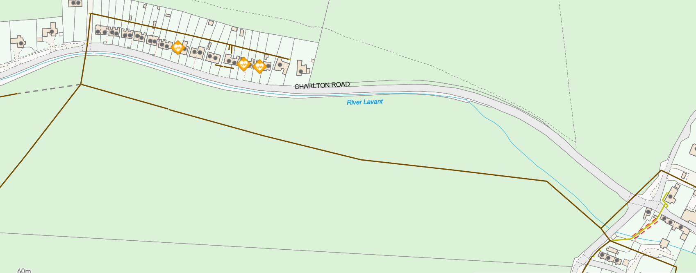
Restriction across the fields
Approximate points camera was unable to pass through

Slide 11
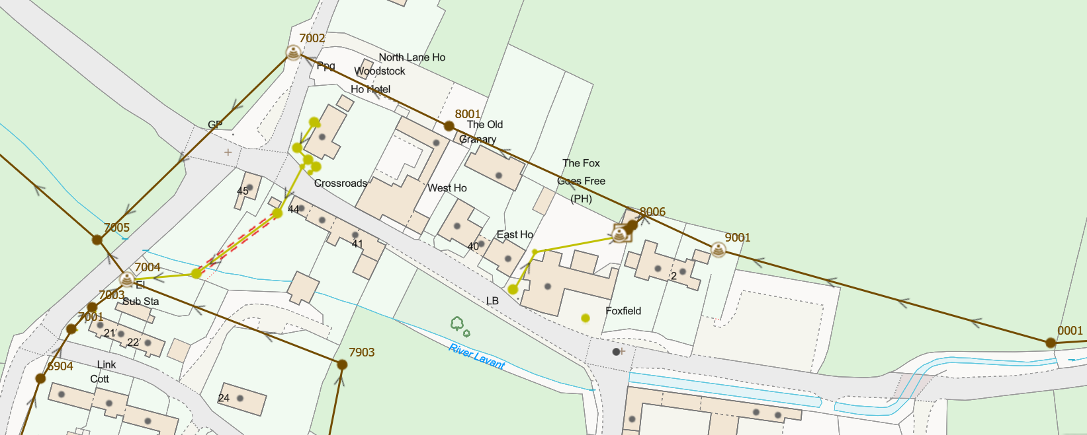
Suspected defect in sewer section
Frequent jetting – attempts made to survey but unable due to high flow conditions

Slide 12
Summary
Total length of public sewer in Lavant system circa 24 km
Based on an estimate of 10m per property of private sewer there is around 15km of private sewer
The public system has all been surveyed in last 10 years by CCTV to identify structural defects
More recently circa 16 km (including the spine system) has been surveyed with Electroscan equipment. This can detect leaking joints which on a CCTV survey appear sound.
52 manholes and 6.4km of sewer found to be leaking has been sealed using leaktight liners
Circa £2m has been spent repairing sewers.
1km of public sewer remains to be lined plus 12 manholes.

